Slide 1
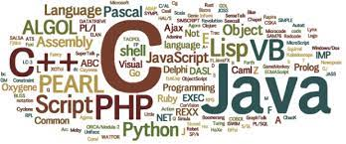
Different types of computer programming languages
By-Chandana MN

Slide 2
WHAT IS PROGRAMMING LANGUAGE?
A programming language is basically a notation which is designed to connect instructions to a computer or a machine.
Programming languages are commonly used to control the performance of a machine as well as to express algorithms.

Slide 3
TYPES OF PROGRAMMING LANGUAGES
Functional Programming Language
Procedural Programming Language
Scripting Programming Language
Object-oriented Programming Language

Slide 4
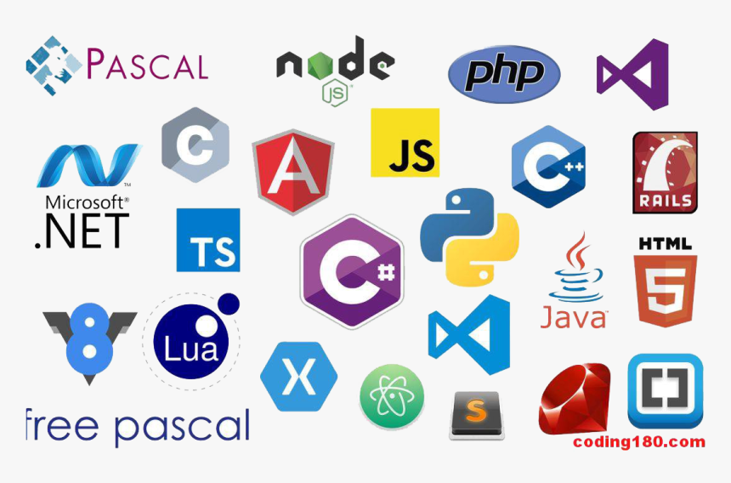
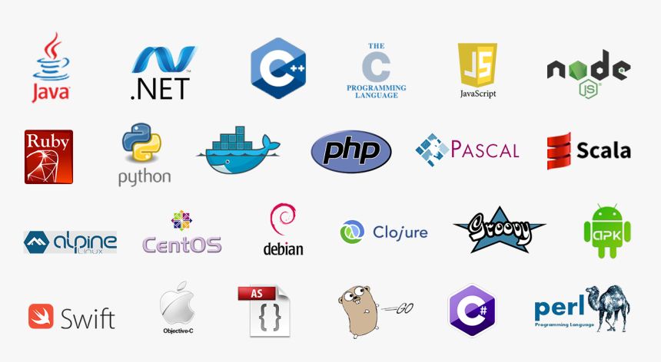
DIFFERENT PROGRAMMING LANGUAGES

Slide 5
C Language
The C language is a basic programming language which is like super popular language across the world.
It is particularly used in game programming and the reason is that C language includes the additional packing of the C++.
Each and every programmer uses this language at some point of time because it makes programs really faster.
However the value of C language gives the reusability of C++ in order to get a slight increase in performance with the C language.

Slide 6
C++ Language
The C++ language is a very popular language which has an object oriented structure and it is used in large projects.
Programmers can easily collaborate one program into different other parts. Also, one individual can work on each part of the program and it would work wonders.
The structure of the object oriented also permits the code to be reused as many times as you want.

Slide 7
Java Language
Java language is basically a multi platform language that is particularly helpful in networking activities.
Needless to say, mostly this language is used on the web with Java applets but this language is also used to design cross platform programs.
This is because it is similar to C++ in structure and syntax.

Slide 8
python
Python is a computer programming language often used to build websites and software, automate tasks, and conduct data analysis.
Python is a general-purpose language, meaning it can be used to create a variety of different programs and isn’t specialized for any specific problems.
This versatility, along with its beginner-friendliness, has made it one of the most-used programming languages today.
Python has been adopted by many non-programmers such as accountants and scientists, for a variety of everyday tasks, like organizing finances.

